Slide 1
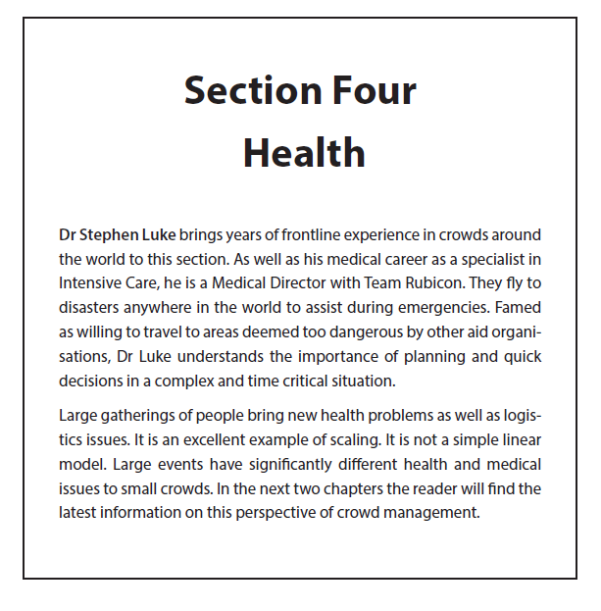

Slide 2
Chapter 9 Integrating Health
Health risk assessment (input)
Integrated health plan (output)

Slide 3
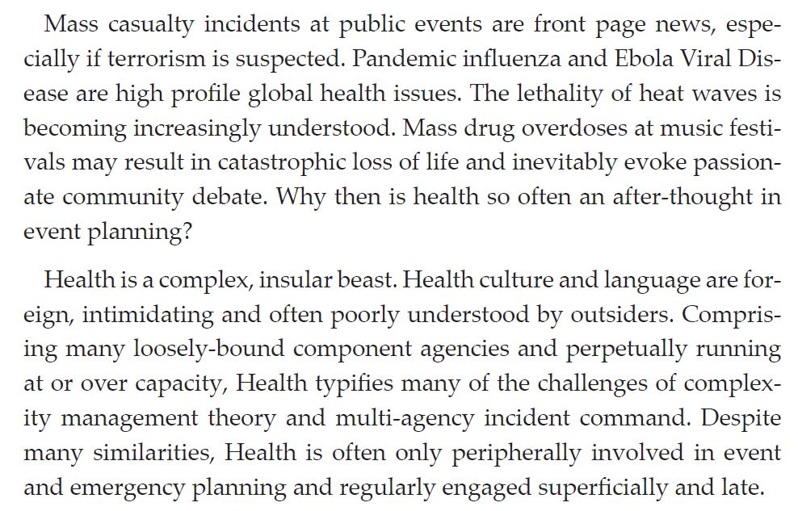

Slide 4
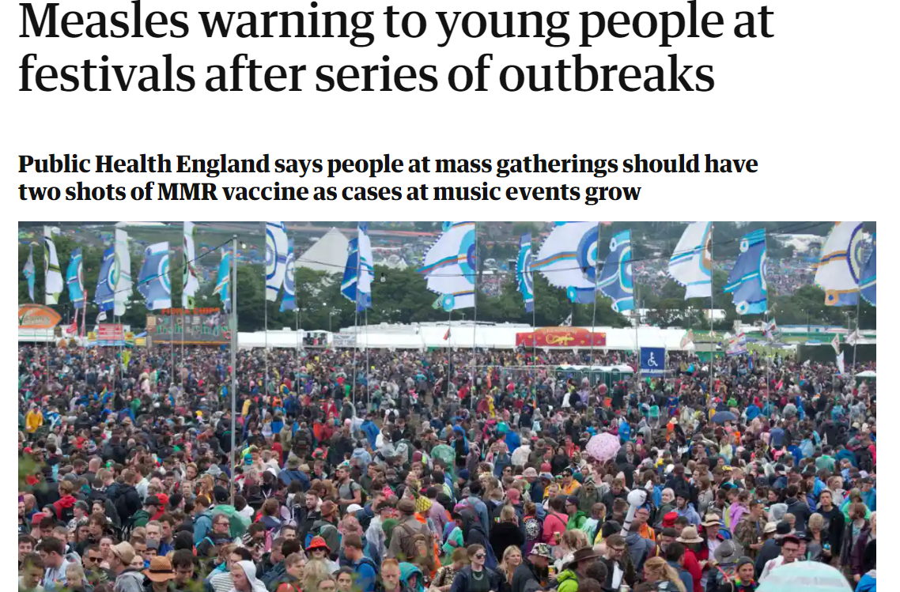
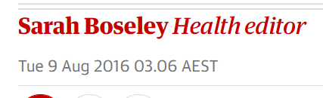
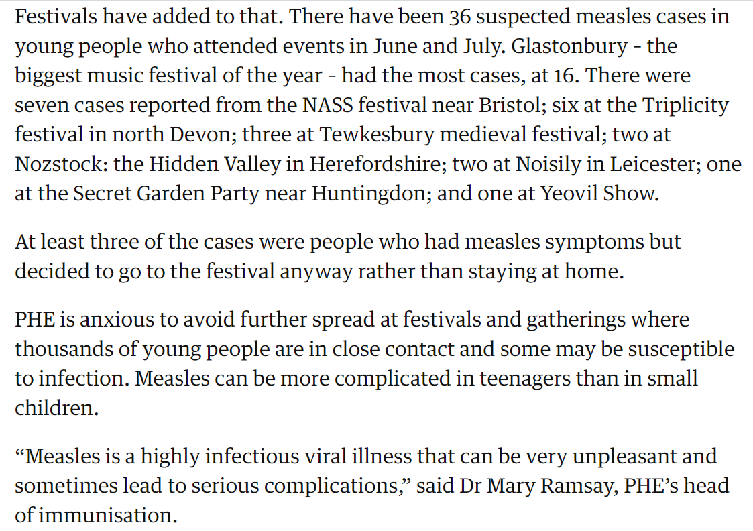

Slide 5
Event health planning
Include health providers in your planning early
How do first aid, ambulance and medical teams fit in to event plan?
How ”health risky” is your event?
Crowd, event, environmental, health factors…
Are there insurance / indemnity considerations?
Start with a Health Risk Assessment
Are there any event-specific risks to address?
Specialist skills – need event health service experience
Public health
More than pandemic planning!

Slide 6
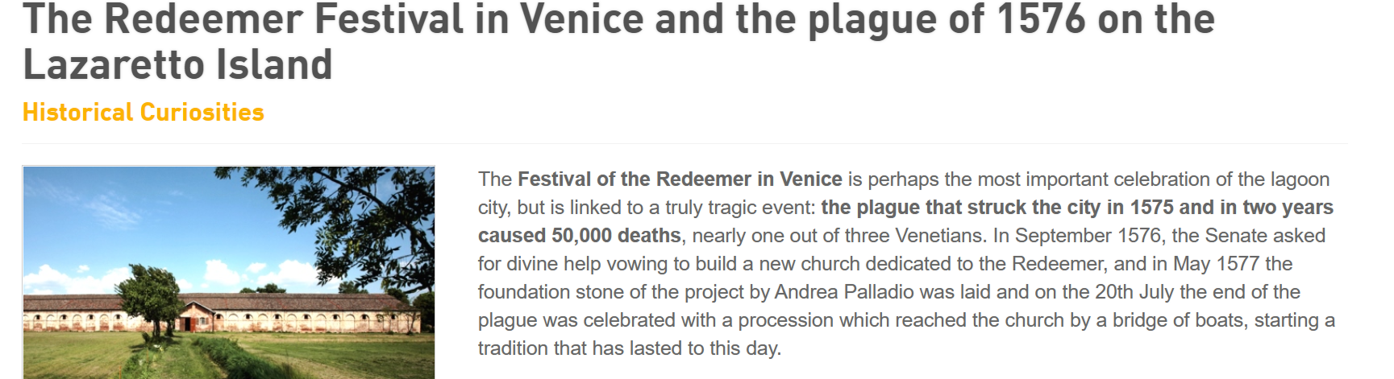
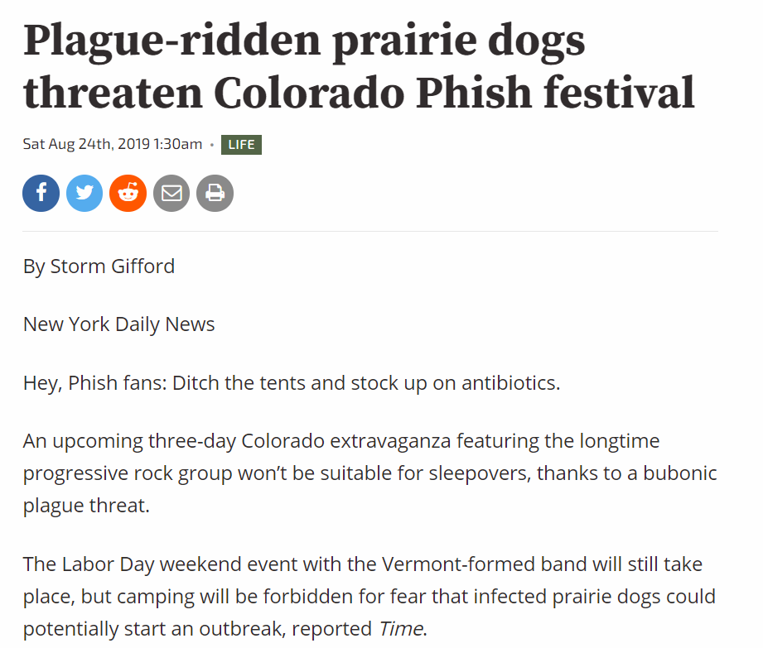

Slide 7
HEALTH FACILITIES
Onsite
First aid & medical facilities
Are they big / clean / quiet / private / warm or cool enough?
Are they in the right place – visibility, access, water, power, crowd?
Would you be happy to be treated in these facilities?
How do these facilities fit in to the rest of the event plan / map?
Is there surge capacity to cope with increased demand?
Offsite
Local ambulance & hospital capacity to manage increased demand
Impact on local community – road access

Slide 8
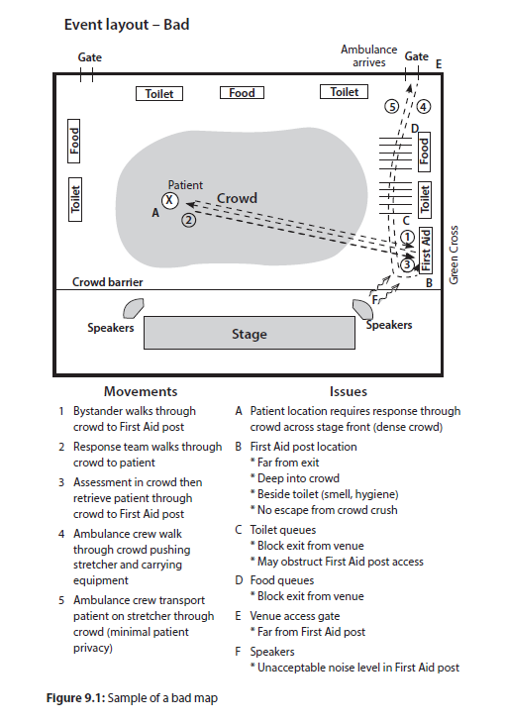
What could go wrong…?
How does an unwell or injured
person get…
help
found in a crowd?
out of a crowd?
Think about location of :
Aid posts
Access points
Crowd crush points
Fences, gates & barriers
Speakers
Could a different layout improve this?

Slide 9
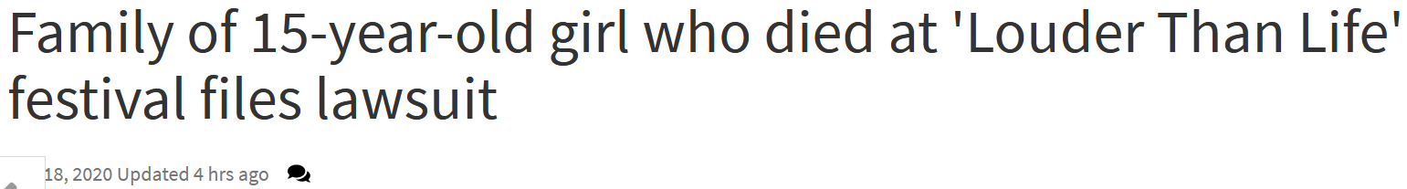

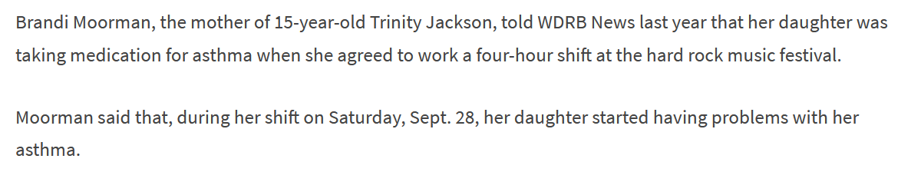
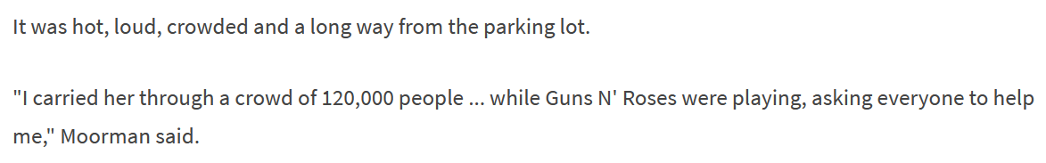
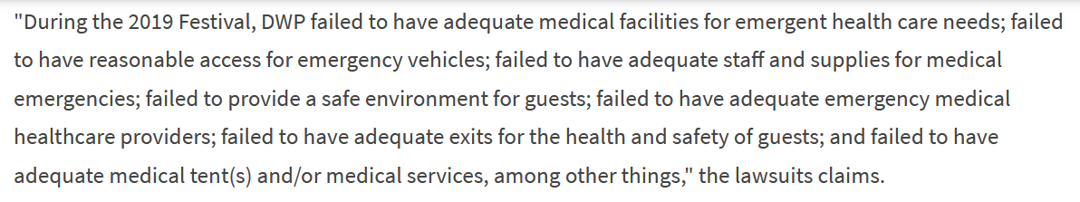

Slide 10
